Slide 1
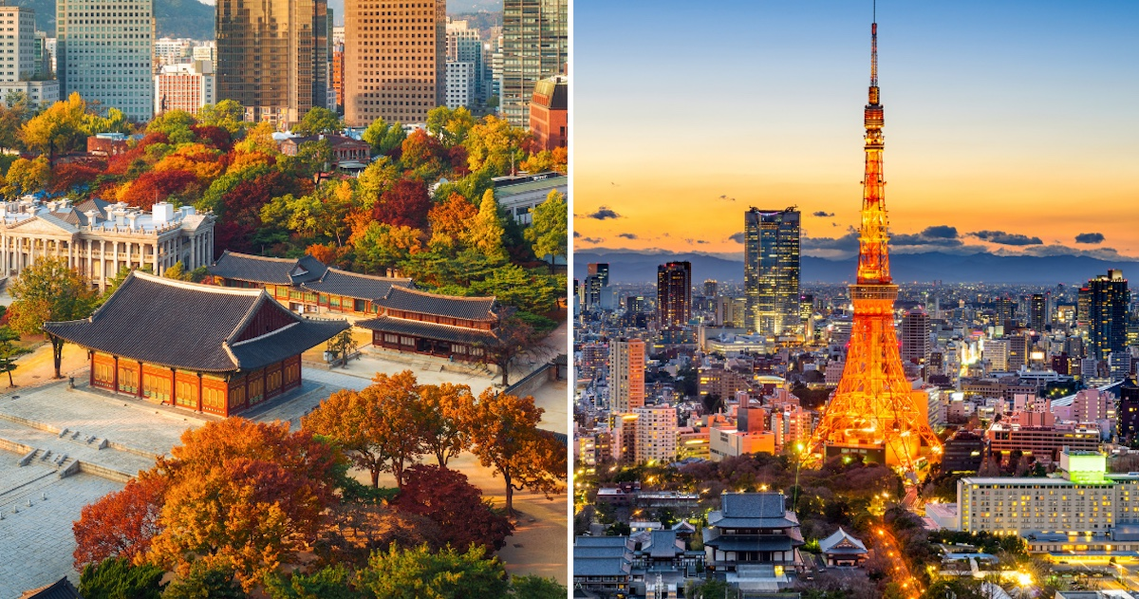
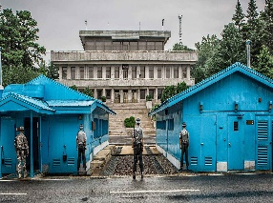
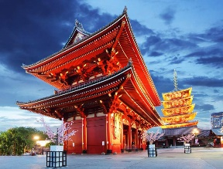
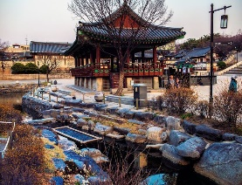
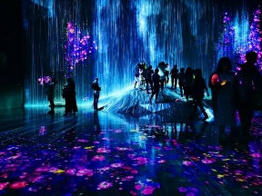
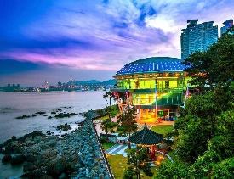
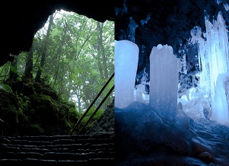
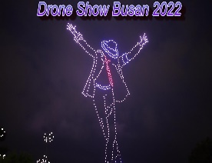
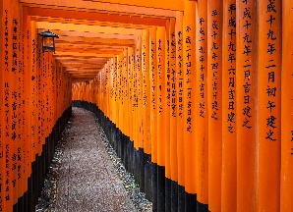
South Korea and Japan
June 17 – June 26, 2025
Join Matthew Haley and Jason Albrecht, in conjunction with Explorica by WorldStrides Student Travel, on a 11-day trip-of-a-lifetime to South Korea and Japan! For more information and complete details please visit us at www.globalxpeditions.weebly.com
TOUR ITINERARY
Day 1: Start Tour
Day 2: Anyong Seoul
Meet our Korean tour director
Hotel check-in
Welcome Korean Dinner
Day 3: Seoul
Travel to the DMZ to see the Dora
Observatory, Imjingak Park, & the
3rd infiltration tunnel
Seoul sightseeing tour: Insadong Cultural street, Cheonggyecheon Canal walk, Namsan Hanok Village visit, N. Seoul Tower and Observatory
Korean Dinner
Day 4: Seoul to Busan
Travel to Busan via the KTX express
Heodong Yonggungsa Temple visit
Dongba island & APEC Nurimaru House visit
Free time on Haeundae Beach
Korean Dinner
Day 5: Busan
Busan guided sightseeing tour of Yongdusan Park, Busan Tower, Jagalchi fish market and the Kukje market
Oryukdo sunrise park
Gamecheon Village
Drone Show at Gwangalli Beach
Korean Dinner
Day 6: Busan to Tokyo
Fly to Tokyo
Meet our Japanese tour director and check into the hotel
Ramen Dinner
Day 7: Tokyo
Tokyo guided sightseeing tour: Visit the Senso-ji temple, the Imperial Palace Garden, the Meiji Shrine and the Harajuku District.
Kendo Experience
Yakiniku Japanese BBQ Dinner
Day 8: Tokyo
TeamLab Planet visit
Attend a Japanese tea ceremony
Tokyo Tower visit
Tempura Dinner
Day 9: Tokyo-Mt. Fuji
Travel to Mt. Fuji
Mt Fuji Wind and Ice Caves visit
Travel to Kyoto
Sushi Dinner
Day 10: Mt. Fuji to Kyoto
Nara excursion: Visit the Nara Deer Park, Todai-ji Temple, and the Kasuga Grand Shrine
Kyoto guided sightseeing tour: Visit the Kinkaku-Ji Temple, the Fushimi Inari Taisha gates, and the Sanjusangen-do Temple
Soba Noodle Farewell Dinner
Day 11: Heading Home
DMZ
Senso-Ji Temple
Namsan Hanok Village
Team Lab Experience
Dongba Island and APEC house
Mt. Fuji Wind and Ice Caves
Drone show at Gwangalli Beach
Fushimi Inari Taisha Gates

Slide 2
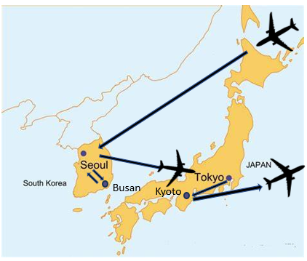
INCLUDED
Round-trip airfare, all transportation, sightseeing tours and site visits, all hotels with private bathroom, breakfast and dinner daily, full-time multi-lingual tour director, required insurance, tips/gratuities, and bus transfer to/from Moscow, Idaho.
NOT INCLUDED
$50 for team building activity fees, $100 for required tips;(both collected March 2024) lunches, beverages and snacks throughout the tour, passport and visa fees, souvenirs and keepsakes, negative covid tests if needed.
TOTAL TOUR COST
Student Traveler: $5,483 $328.56/mo.
Adult Traveler: $5,999* $374.94/mo. *Price will be adjusted by Feb. 2024
FLEXIBLE PAYMENT PLANS
Option 1: Monthly Automated Plan:
$50 Deposit plus $176 Travel Insurance (required) due at sign-up ($226 due at sign-up)
Billed automatically to your credit card or checking account
Balance divided into equal monthly payments
Option 2: Full Payment Plan:
Pay in full at time of enrollment
Option 3: 4-Step Manual Plan (not automatic):
$99 Deposit plus $176 Travel Insurance (required) due at sign-up ($275 due at sign-up)
30 days after registration, 2nd payment of $500 is due
75% of your balance due 110 days prior to departure
Remainder of balance due 65 days prior to departure
WANT TO LEARN MORE?
On November 6, 2023, at 7pm at Moscow Middle School in the Multipurpose Room
We will present information about the trip, dates/itinerary, trip requirements, finalized costs, payment options, and fundraising opportunities.
We will also distribute tour applications and answer any questions that may arise at this meeting.
This opportunity is available for Class of 2028 to 2031 students in Moscow and the surrounding communities, as well as their parents or adult relatives.
All eligible travelers must be fully vaccinated and boosted (4 shots total) from Covid-19 prior to travel.
We are very excited about this travel opportunity and hope you will consider applying for this wonderful travel adventure.
NOTE: This trip is not affiliated with Moscow Middle School or the Moscow School District. It is an independent student/parent educational opportunity.
“The World is a book, and those who do not travel read only a page.” – Saint Augustine

